Slide 1

Getting Started in Data Science: Data Acquisition and Wrangling
Difficulty level: basic-intermediate
Notes:
In most scenarios, the ”big data” that you need for the data analytics task you want to perform is not actually sitting there: you have to pull it in, put it together and make it useable.
In this lecture, we will show an example of acquiring and wrangling data by extracting and integrating open web data (largely from Wikipedia).
Our goal is to introduce the basic data structures used in data science (dataframes / tables / relations; matrices / arrays; nested structures / XML / JSON), then show what is involved in getting remote, semi-structured, and structured data into a form that we can use in visualization, descriptive statistics, or prediction. Along the way, we introduce the basics of web crawling and HTML parsing, XPath extraction, and the relational algebra. We then illustrate data integration and wrangling issues including nulls, joins, cleaning rules, and approximate matching.

Slide 2
What We Need for Data Analytics: Well-Structured Data
features
The data “instances” are observations or samples from a population
Each has many features – measurable properties or characteristics
Requires a journey from “raw data” to a single tabular representation!
instances
Reports
Visualizations
Classifiers
Except where otherwise noted, this work is licensed under a Creative Commons Attribution-ShareAlike 4.0 International License.
Notes:
A typical ML course starts with the data in a giant spreadsheet (table) over which the analytics task is performed. In this table, the rows are instances (observations/samples, for example a customer or a purchase), and the columns represent features (measurable properties, e.g. quantity and the price). Using this, you can perform various types of computations such as reports (e.g. for every quarter how many purchases; for every quarter, how many purchases by region, etc),
In the 90’s this was called “big data”, and data warehouses were designed to create these types of reports. Companies like Walmart made their businesses competitive by being able to rapidly create reports, and eyeball them to (for example) make predictions of what to stock in what store in what season.
It’s been a long time since the 90’s, and things have advanced. Just showing spreadsheets and reports is not that interesting, and may not convey meaning quickly. Data scientists therefore turn to visualizations nowadays to understand the data, and a number of great tools have been designed to put this into the hands of practitioners and enable things like interactive visualizations.
Most people focus on the last box in this slide, “classifier”, which looks at new data and makes predictions about what it is or where it is going. That’s the big picture view.
But if you talk to people who are actually working at Data Science companies (Palantir, IBM consulting , Accenture, etc) there is a lot that goes on before you get to this spreadsheet. There is a journey from the raw data to this structured form which is the focus of this lecture.

Slide 3
Three Basic Encodings of Structured Data
Tables
id | last | first | hair | height | handed | label
1 | Li | C | Brn | 5’6” | Left | T
2 | Prakash | A | Blk | 5’8” | Right | T
3 | Jones | L | Blk | 6’3” | Ambi | F
Comprised of tuples that may have different field types
Also called dataframes (Pandas, R, PySpark) and relations (SQL)
Except where otherwise noted, this work is licensed under a Creative Commons Attribution-ShareAlike 4.0 International License.
Notes:
Let’s start with three basic abstractions of structured data.
The data that we spoke about on the previous slide is an example of tables or relations.
Tables are available in most popular languages used in Data Science, e.g. Python Pandas, R and PySpark, where they are called “dataframes”. A dataframe is a table with positions on the rows and names on fields.
Tables are also the fundamental concept in relational databases, where they are also called “relations”. A relation is a table but doesn’t pay attention to order – so there are no positions on rows. This is such a small subtley that we will just assume for now that relations, dataframes, .csv files etc are all the same thing - tables.

Slide 4
Three Basic Encodings of Structured Data
Tables
Arrays
id | last | first | hair | height | handed | label
1 | Li | C | Brn | 5’6” | Left | T
2 | Prakash | A | Blk | 5’8” | Right | T
3 | Jones | L | Blk | 6’3” | Ambi | F
1 | 3 | 2
3 | 1 | 0
2 | 0 | 1
Comprised of tuples that may have different field types
Also called dataframes (Pandas, R, PySpark) and relations (SQL)
Cells have same type, in a multi-dimensional coordinate space
Matrices, tensors
Except where otherwise noted, this work is licensed under a Creative Commons Attribution-ShareAlike 4.0 International License.
Notes:
The second type of structured data are arrays and matrices, which we will see a lot more of later. In arrays, rows are still observations and columns are still features – but columns are indexed (positional) rather than named. More importantly, rather than every column potentially having a different type (e.g. “Name” is string while “Weight” is integer), all columns and therefore all entries have the same type.
Apart from that, there is not a huge difference between a two dimensional array and a table.

Slide 5
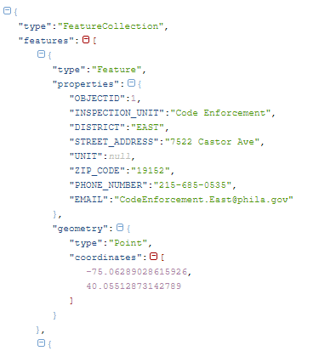
Three Basic Encodings of Structured Data
Tables
Arrays
Dictionary
id | last | first | hair | height | handed | label
1 | Li | C | Brn | 5’6” | Left | T
2 | Prakash | A | Blk | 5’8” | Right | T
3 | Jones | L | Blk | 6’3” | Ambi | F
1 | 3 | 2
3 | 1 | 0
2 | 0 | 1
Comprised of tuples that may have different field types
Also called dataframes (Pandas, R, PySpark) and relations (SQL)
Cells have same type, in a multi-dimensional coordinate space
Matrices, tensors
opendataphilly.org
Compositions of dictionaries (maps) and lists
JSON, XML, objects
Notes:
The third type of structured data that we will again see more of later when we deal with Web data, XML, objects, JSON data etc. is nested data, represented by dictionaries. Dictionaries have (key, value) pairs, where the value can be simple (string, integer, etc), or a list of values, or a nested dictionary. Many public datasets are released by the government in JSON format. The example on the right is a dictionary from opendataphilly.org, the Philadelphia regional government public dataset, and it is about Geocoded information about traffic violations in some particular location in the city. This data can be split up into subcomponents which again begin to look like tables.
For this lecture, we are going to focus on tables.

Slide 6
Structuring Data: Acquisition → Wrangling → Integration → Cleaning
Extraction based
on patterns
Text
Text
Text
Web crawl
APIs
Database
Structured data
Notes:
In general, we are going to pull data in from wherever it lives, which is usually remote and not on our laptop, and turn it into tables. For example, we may need to analyze text or linked HTML files, looking for patterns to extract the entities we are interested in (we will see this later). We may pull in data from a remote database, or import .csv or .json files. Somehow we have to get raw data into multiple tables.

Slide 7
Structuring Data: Acquisition → Wrangling → Integration → Cleaning
Extraction based
on patterns
Text
Integration &
feature extraction
Cleaning
Text
Text
Web crawl
APIs
Database
Reports
Visualizations
Structured data
Classifiers
Notes:
Then there is a step in which we combine the tables into a unified table.
There are lots of tricks involved in integrating and cleaning the data, figuring out what fields you need, and whether data from different fields have to be combined to create the data you need for the downstream analysis.

Slide 8
Structuring Data in the Context of a Web Data Task
Difficulty level: basic

Slide 9
Example for this Segment
Follow this example at DATA-WRANGING-import-link.mixed.ipynb
Hypothesis: CEOs of major companies are typically in their 40s and older
Analysis: Identify top companies, CEOs, and the distribution of their ages
Issues:
Where do we find authoritative data?
How do we load it in?
How do we link it together?
Let’s start with three simple data sources:
A file with a big list of companies and categories – in comma-separated values (.csv)
A table of companies and CEOs in a Wikipedia page (.html)
Content from HTML pages on people (from Wikipedia)
Notes:
Suppose we are interested in knowing the typical age of CEOs of major companies. How can we do this using Jupyter notebook on your laptop? Suppose we have a file of companies and categories (this is on Github), and need to find some authoritative data about CEOs. It turns out that there is a list of companies and their CEOs on Wikipedia, which we are going to assume authoritative and up to date. But it doesn’t have information about ages, so we may need to extract that information from the HTML pages of people (CEOs), again from Wikipedia.
The first two sources are already well structured, the third is more complicated.
We’ll start with just loading the data.

Slide 10
Acquiring Structured Data
Difficulty level: basic

Slide 11
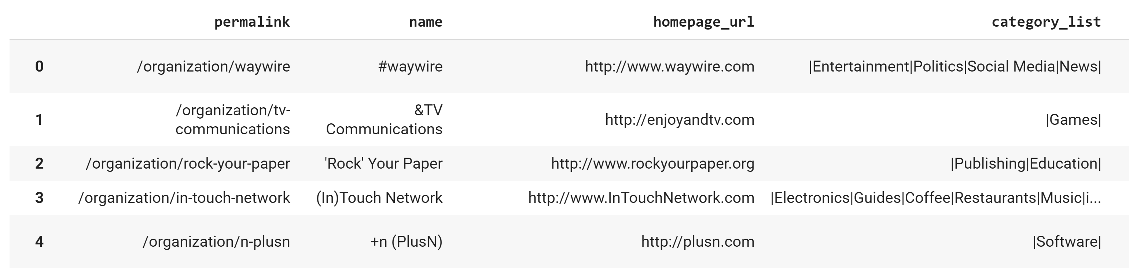
Acquiring Data (1/3): Reading file with companies and their categories.
Fetch using urllib, read using Pandas’ read_csv:
import urllib
import pandas as pd
data = urllib.request.urlopen('https://gist.githubusercontent.com/jvilledieu/c3afe5bc21da28880a30/raw/a344034b82a11433ba6f149afa47e57567d4a18f/Companies.csv')
company_data_df = pd.read_csv(data)
Notes:
The simplest way that people export data is “comma separated values” (csv’s). Here there is one line of text per row, with commas between attribute values. There is some variation as to whether the names of the columns are provided (frequently as the first row of the file), or whether the column names are not provided. There is also an issue of what to do about commas that are part of the value of a field. So you will have to look at the Python handbook for how to specify what type of csv file you are working with.

Slide 12
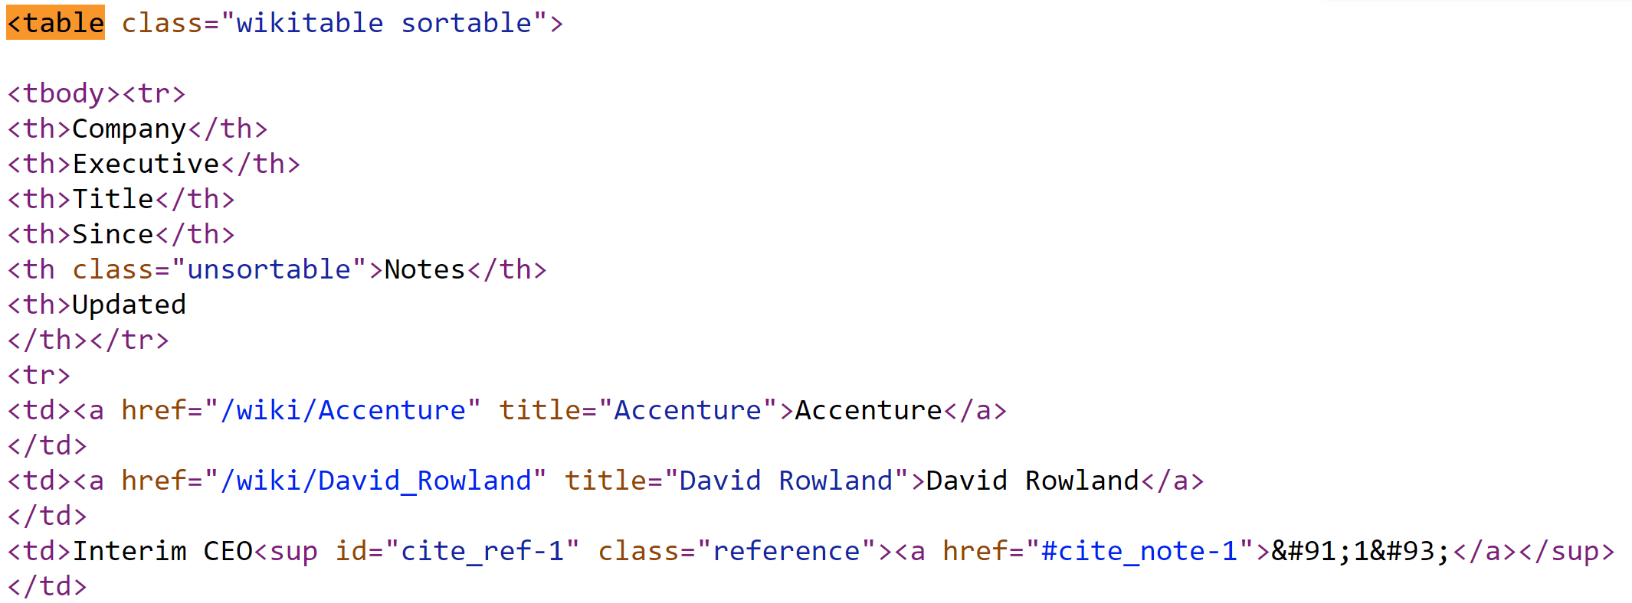
Acquiring Data (2/3): Reading table of companies and CEOs from Wikipedia page.
Import from files using Pandas’ read_html:
company_ceos_df = pd.read_html( 'https://en.wikipedia.org/wiki/List_of_chief_executive_officers#List_of_CEOs')[0]
Takes the first (0th) HTML table (see below) …
…
Notes:
Now we obtain the list of CEOs from Wikipedia. The html shown has a table with information we need: the company name (Accenture), the CEO (David Rowland), interim CEO, etc.
There is one of these for each of the companies.
This is useful because the Pandas read_html command takes an http address and returns a list of tables as Dataframes. Having looked at the Wikipedia page, we know it is the first table on the page and therefore specify the index 0 table as the dataframe of interest.

Slide 13
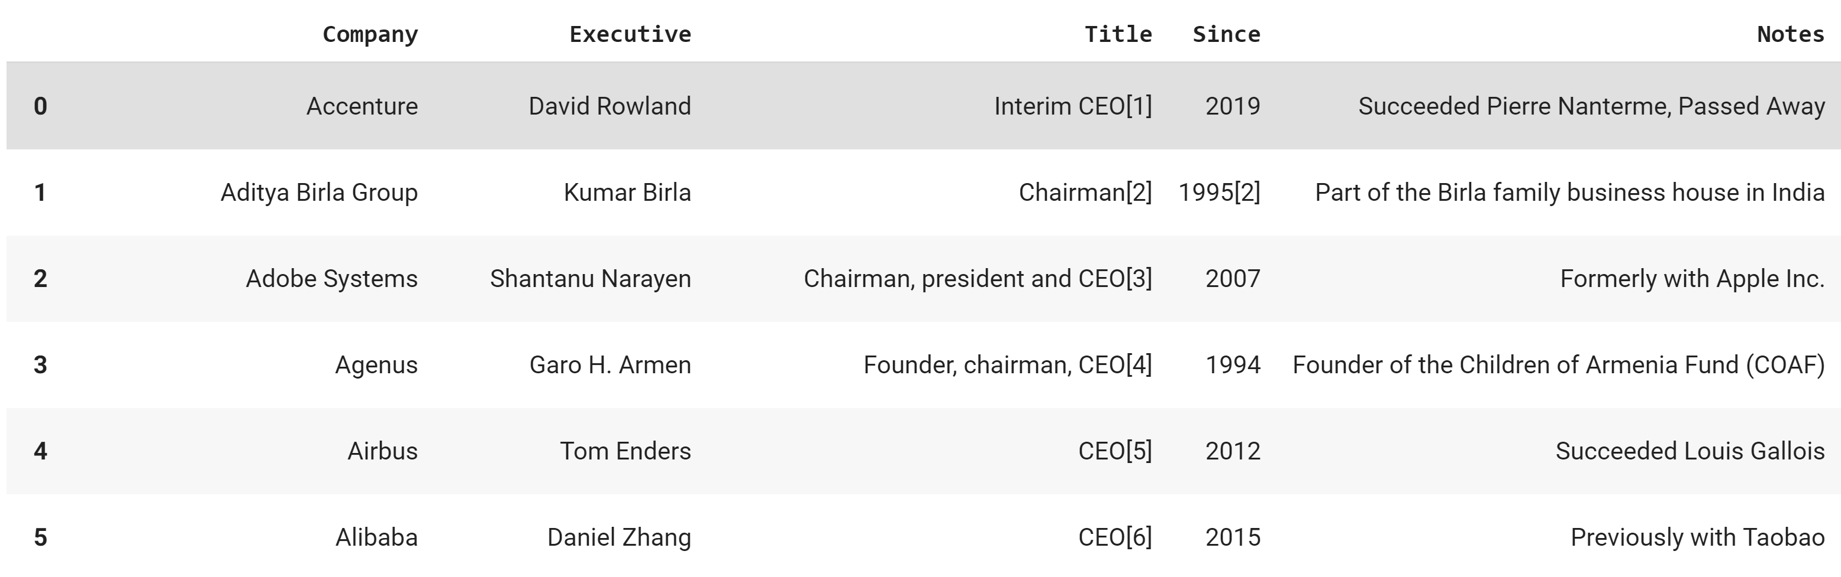
Acquiring Data (2/3): Reading table of companies and CEOs from Wikipedia page.
Import from files using Pandas’ read_html:
company_ceos_df = pd.read_html( 'https://en.wikipedia.org/wiki/List_of_chief_executive_officers#List_of_CEOs')[0]
… and turns it into a DataFrame.
Notes:
Here is the result of the read_html command, you can see that it is a dataframe with Company and Executive (presumably the CEO). There are some funny things in the dataframe, for example “Interim CEO[1]” where the [1] probably is a reference to the source of information. We might need to fix this later, which is a task for data cleaning. We will also need to use the name of the executive to find their Wikipedia page and extract information about when they were born, but that is fairly easy.
Very easy so far… but it gets harder.

Slide 14
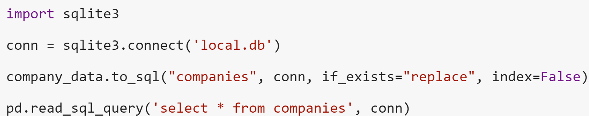
Persisting data to & reading from a Database Management System (DBMS)
For reasons of efficiency, and because web pages change over time, it is useful to persist the current copy.
This uses a simple relational DBMS called sqlite – if you want to share data you should probably use something like PostgreSQL on the Cloud
Notes:
Another easy case (which we will not use for this example) is if the data you want is in an SQL database. Pandas gives you the ability to easily move data between a database and a dataframe. For this class, we will often use sqlite which is a lightweight database, one that you would use as a personal database rather than one serving a hundred users. For a large number of users, you would use MySQL or Postgres, or any number of other relational database management systems.
To talk to a database, you first connect to it. You can then put a dataframe into the database using to_sql, and get a dataframe out of the database by querying it (read_sql_query).
With to_sql, you specify the name of the table, the connection to the database, whether you want to overwrite the table if it already exists, and whether you want to save the index number from the dataframe as a field in the database relation (in our case, the index is not helpful so specify index=False).
With read_sql_query, you specify a query and the connection. The query ‘select * from companies’ just returns all columns of all rows of the table companies.
The result is put into a dataframe.

Slide 15
The Story So Far
Acquiring data is pretty easy IF it is structured, e.g.:
CSV, with labels
HTML tables, with regular rows and columns
Relational database
Importing from CSV or HTML can be slow, and links can break. So using a DBMS to store the data locally is a good idea!
Beware that the DBMS is NOT part of Jupyter Notebook, so you may need to host the DBMS on a server on the cloud.
Now, let’s consider what happens if the data isn’t so easy to import!

Slide 16
Extracting Information from Unstructured Data
Difficulty level: intermediate

Slide 17
Finding Complementary Web Data
Using company_ceos_df, find additional information on the webpages of CEOs.
Executive names to URLs: “David Rowland” → “https://en.wikipedia.org/wiki/David_Rowland”
Notes:
Observe that the executive names in company_cdos_df can be appended onto the http address for wikipedia to obtain the web pages of CEOs. This is where additional information, such as birth dates, may be found.

Slide 18
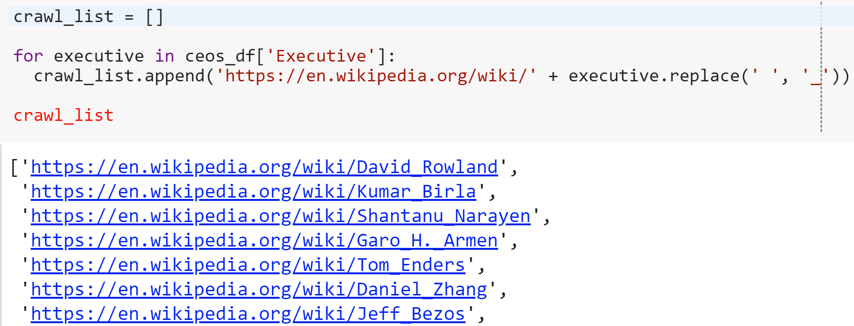
Finding Complementary Web Data
Using company_ceos_df, find additional information on the webpages of CEOs.
Executive names to URLs: “David Rowland” → “https://en.wikipedia.org/wiki/David_Rowland”
We need to project the executive name to obtain their webpages.
Notes:
We will therefore extract the names of CEOS using “projection”, which essentially subsets the data by column. Projection is written as “ceos_df[‘Executive’]” in Pandas, and yields a list of strings of Executive names.

Slide 19
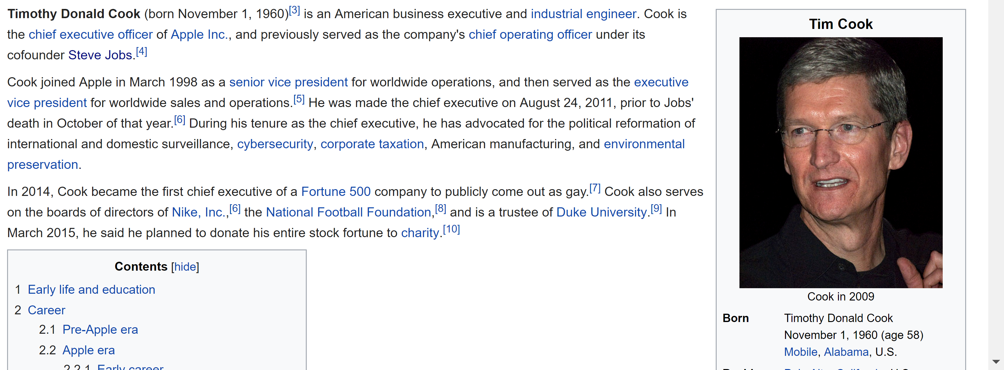
What Does a CEO Webpage Look Like?
Goal: extract information about date of birth.
We pull the HTML page via urllib (or a web crawler like scrapy)
Notes:
Taking a look at the webpage of one CEO, we see that the date of birth is in a special area of the web page.

Slide 20
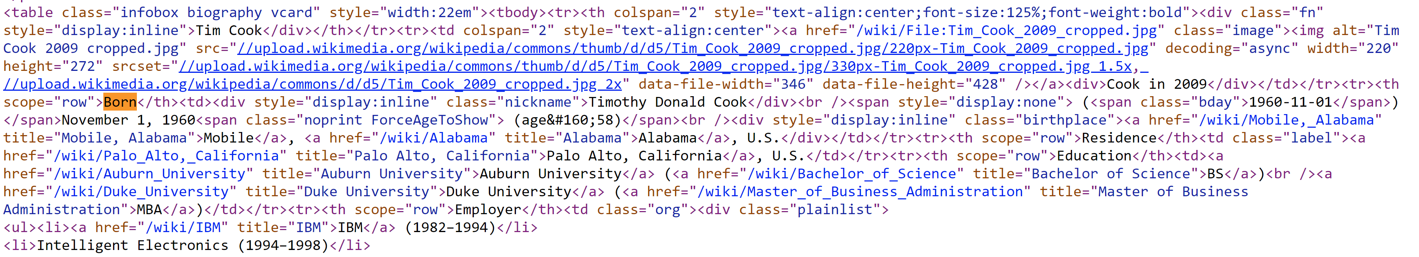
What Does the HTML Look Like?
… (lots of stuff before the portion of interest)
Notes:
Looking at the underlying HTML of the webpage, we can see that embedded in the larger HTML document there is a vcard table shown at the top, out of which we will eventually want to pull the information about “Born” (shown in orange). We will do this using a language called XPath, and to understand XPath it is useful to think of the HTML structured as a tree.

Slide 21
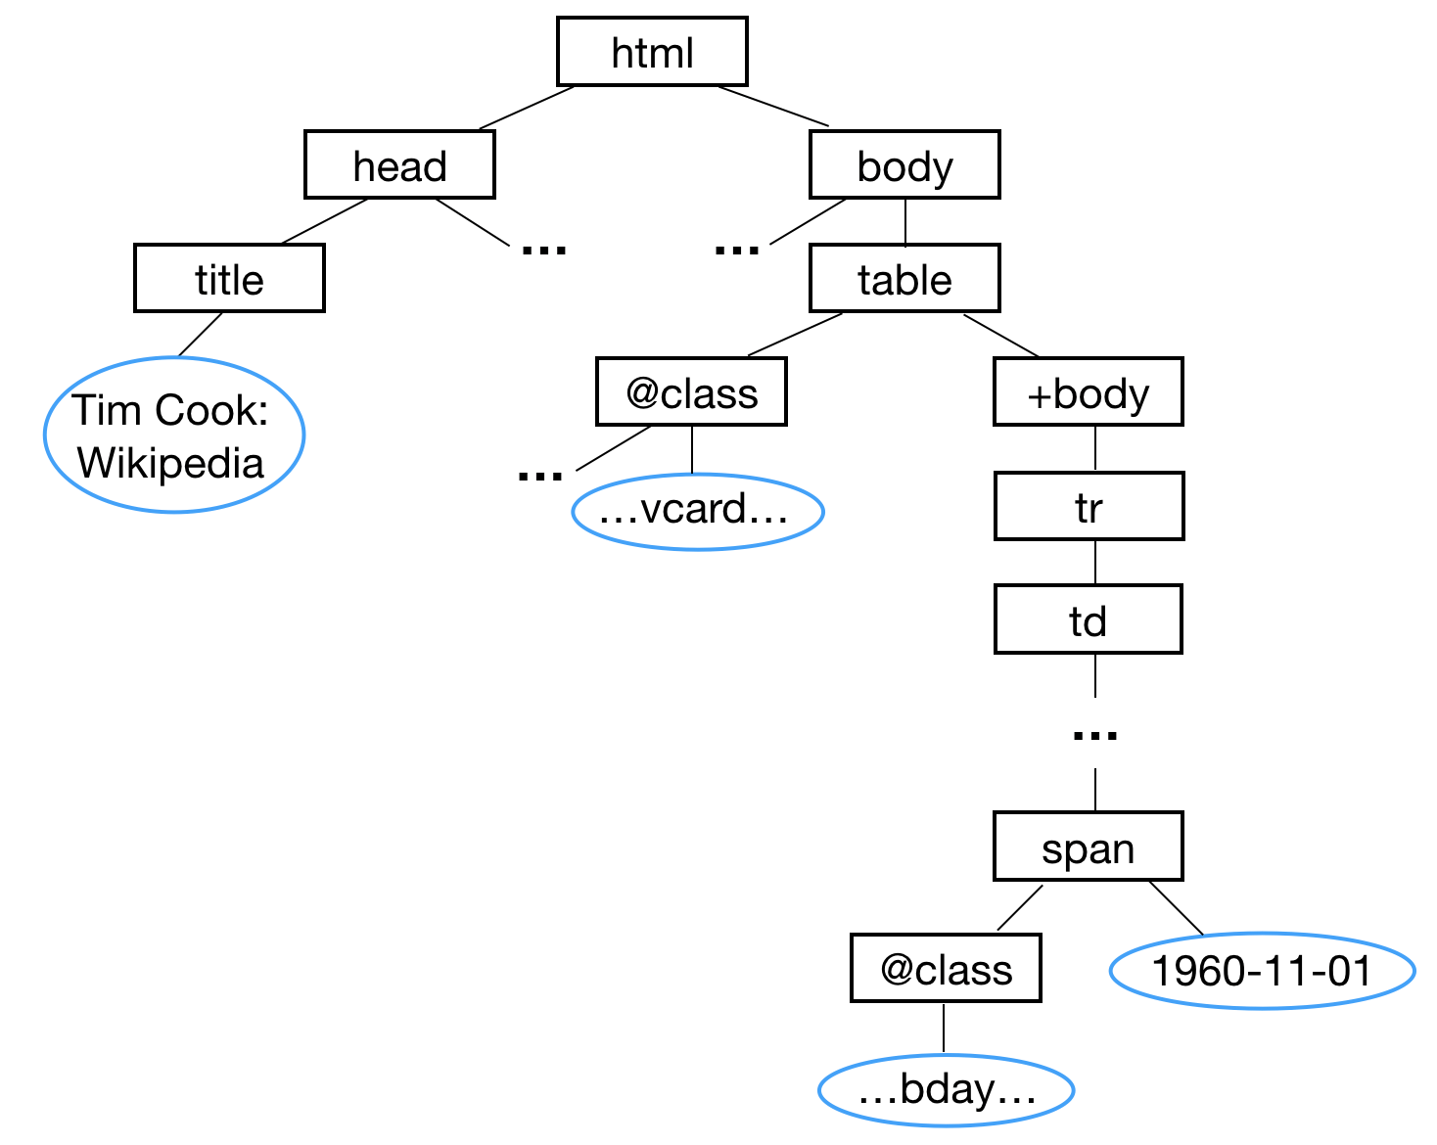
Tree Representation of the HTML Web Page
We parse the page to turn the HTML into a tree of XML elements using etree
Notes:
This is the tree corresponding to the HTML on the previous page.

Slide 22
Tree Representation of the HTML Web Page
We parse the page to turn the HTML into a tree of XML elements using etree
… and use XPath to extract the “vcard” table
Notes:
Note that the content that we want is in the table for which vcard is one of the classes (leaf of right subtree, … shows that there are other classes in the string associated with @class), and that the bday is in the body of the table. The path to the table we are interested in is shown in red.

Slide 23
Finding the Vcard Table Subtree
The HTML tree is represented using the Document Object Model (DOM), which has a method called “xpath” that finds a list of nodes at the end of a specified path.
The xpath below shows the path in red. It finds nodes at any distance from the root (“//”, descendent traversal) with label “table” with an attribute “class” that contains the value “vcard”.
We can extend that path to extract bday information in the vcard subtree:
//table[contains(@class,"vcard")]
//table[contains(@class,"vcard")]//tbody/tr/td//span[@class="bday"]/text()
Notes:
XPath has several “navigation” axis – child (/) , descendant (//), parent (.), ancestor (..) which can be combined in expressions.
Conditions can also be specified to restrict matching elements, e.g. “contains(@class, “vcard”)” only returns tables of that class.
“text()” extracts the text at the leaf of the tree.

Slide 24
XPath and Its Use in Information Extraction (IE)
XPath is quite a rich language – see https://www.w3schools.com/xml/xpath_intro.asp
Main take-aways about XPath:
Simplifies matching within DOM,
Roughly corresponds to pathnames in Unix
Returns ordered sets of nodes (as lists in Python)
Main parts are path steps
Many tools are built using this, see https://blog.scrapinghub.com/
Microsoft Excel FlashFill and Trifacta try to learn similar patterns over strings
Later we’ll look at how we can do IE over text phrases!

Slide 25
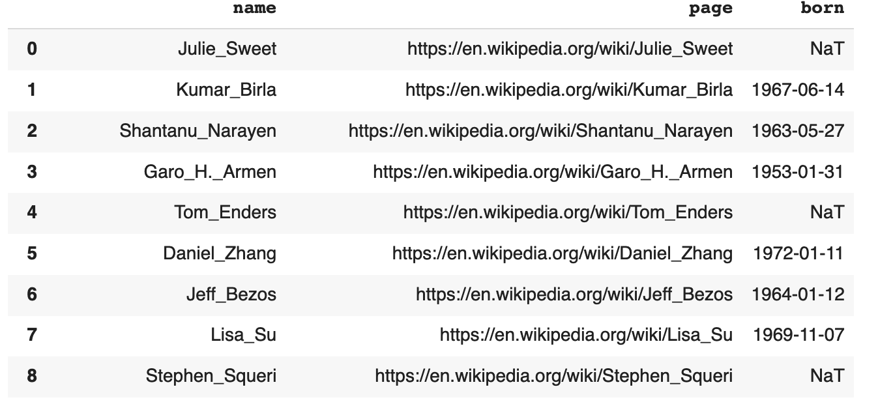
Acquiring Data, 3/3:Creating execs_df
We initialize execs_df with the name of the CEO, the web page …

Slide 26
Acquiring Data, 3/3:Creating execs_df
and born. If there is no bday then it is initialized to NaT
'born': datetime.datetime.strptime(bday[0], '%Y-%m-%d')
Notes:
Recall that the born value is extracted using the xpath expression described earlier. We convert it to datetime as shown. If there is no bday, then it will be null (NaT is the special null value for datetime types). For other types, it is NaN – but for either, you will have to be careful of how you handle it during analysis. Sometimes you will throw the row away, sometimes you will calculate some value (e.g. average) – but this is not always a good idea.

Slide 27
We Have Structured Data – Are We Done Yet?
Not really – now we have lots of data in different places!
company_data_df
company_ceos_df
execs_df
Is the data clean?
How do we link the data?
Notes:
We now want to take this data and check how clean and complete it is, and then put all the data together.
So we are moving from obtaining the data, to some basic operations over dataframes and SQL: projecting and selecting. In the next part, we will show these bulk operations using both Dataframes and SQL.

Slide 28
Cleaning Data (and Single Table Operations)
Difficulty level: basic

Slide 29
company_ceos_df:
execs_df:
Need to clean name
Notes:
We want to link between these two tables, but the names in execs_df have underscores (circled). So we need to “clean” the data to get rid of the underscores.

Slide 30
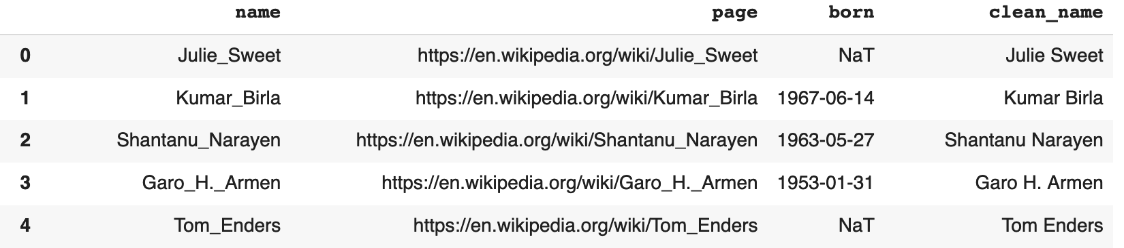
Use Projection and apply to Update Names in Parallel!
We project the executive name and replace it with the clean name.
exec_df['clean_name'] = exec_df['name'].apply(lambda x: x.replace('_', ' '))
Python can use multiple threads, cores, or CPUs to process different rows of the data at the same time!
(To do this we need a bit more than Pandas, e.g., Dask, Swifter, Spark…)
Notes:
We are cleaning the names by replacing “_” with a space “ “, and in doing so using “projection” (exec_df[‘clean_name’] ) and “apply”.
Note that Pandas differentiates between Dataframes (multi-column, multi-row) and Series (single column, multi-row). The operations you can do over a dataframe and series differ.
So exec_df[‘clean_name’] returns a single column as a Series, exec_df[[‘clean_name’]] returns a dataframe. In this example, we are operating over a series and applying (“apply”) a function over each element; Lambda x indicates a function that is used just for this operation.
We could also have done this using a for loop, but using apply signals a “bulk” operation that can be executed in different ways, e.g. using parallelism. A for loop would not allow this. This style of programming is very common for big data processing.
(Surprisingly, the built-in Pandas apply as of 2019 doesn’t use multicores– but it might in the future. If you want it now use Dask, Swifter, Spark, etc.)

Slide 31
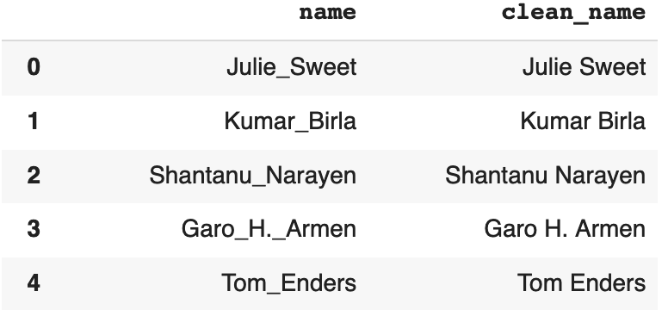
What if the Data is in a Database?
Dataframes must fit in memory… but what if the data is too large to fit in memory? Or what if the data is already stored in a database?
Use SQL!
exec_df.to_sql('temp_exec', conn, if_exists="replace")
pd.read_sql_query('select name, replace(name, "_", " ") as clean_name from temp_exec', conn)
Notes:
The SQL version of the same thing is here.
We are putting exec_df in a table called temp_exec, and then using SQL to clean.
Note that projection in SQL is done by specifying the column(s) to be projected over in the SELECT clause. “replace” is a function that is taking the name as an argument and performing a replacement of _ by space. The result attribute is specified as “clean_name”.

Slide 32
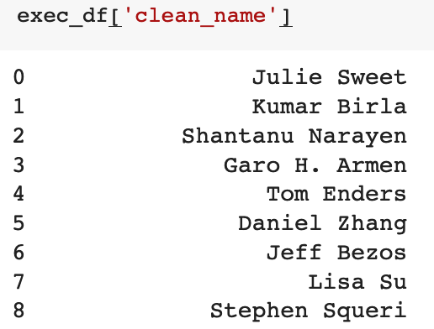
Another Bulk Operation: Selecting Only Some of the Rows
…
Notes:
Let’s talk about another bulk operation that is commonly used in Dataframes and SQL: SELECTION based on a predicate.
The way Pandas does this is not very intuitive. Let’s warm up by doing a projection yielding a series (exec_df[‘clean_name’]), shown here.

Slide 33
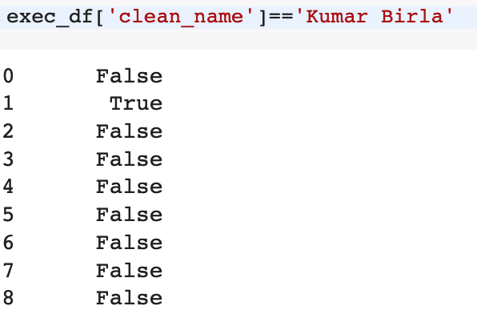
Another Bulk Operation: Selecting Only Some of the Rows
…
…
Notes:
If we want only one person (Kumar Birla), we apply a predicate to the series – sort of like apply earlier. This gives a truth value for each of the elements of the series, a boolean series.

Slide 34
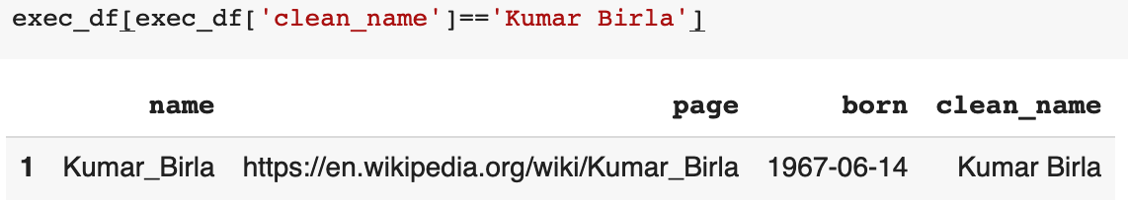
Another Bulk Operation: Selecting Only Some of the Rows
Notes:
We can now extract rows of interest using these Boolean values to extract only those rows which are “true”.
This gives us a dataframe including only those rows satisfying the condition; here it returns the rows with clean_name =“Kumar Birla’).

Slide 35
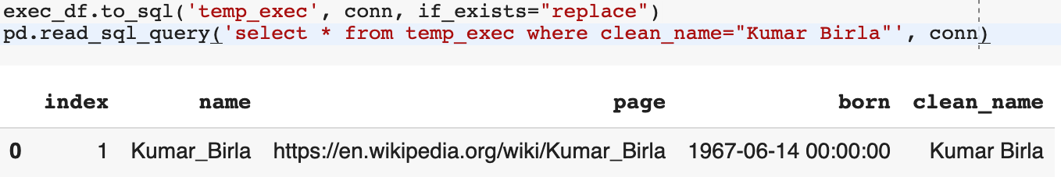
Selection in SQL…
We’ll see later: with SQL the database can use indexing
or sharding to make this fast and/or parallelized!
Notes:
We can also select in SQL using the condition ‘clean_name=“Kumar Birla” ‘ in the WHERE clause.

Slide 36
Now We Have a Basic Set of Operations Over (Single) Tables
Projection – pull out a “slice” of the table on certain columns
Selection – pull out rows matching conditions
apply() to compute over columns
In-place updates for Dataframes
Basic SQL: select columns, expressions from table where conditions

Slide 37
Linking Data
Difficulty level: basic

Slide 38
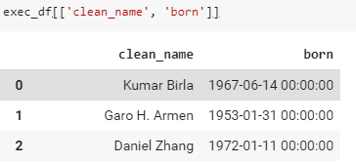
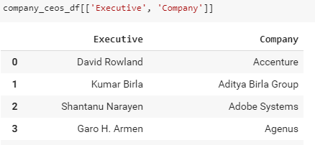
Can We Put the Data Together?
company_ceos_df
execs_df
We now want to “connect” the data – we can do this via a merge (aka a join), which matches rows with the same value
Notes:
We still have the task of linking the two dataframes together. To do this we use the bulk operation merge (join).
So that the example fits on a slide, we will project both tables on the necessary columns:
Company_ceos_df[[‘Executive’, ‘Company’]] creates a DATAFRAME (not series) with only the columns listed; same for exec_df.
This shows the difference in a projection yielding a series (shown earlier) versus one yielding a Dataframe (note the use of double brackets).

Slide 39
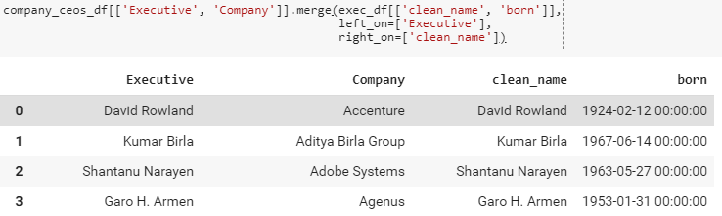
The Join (Merge) Operation
Notes:
We will merge the two (projected) Dataframes under the condition that the Executive column value in company_ceos_df[[‘Executive’, ‘Company’]] (left on) matches the clean_name value in exec_df[‘clean_name’, ‘born’]].

Slide 40
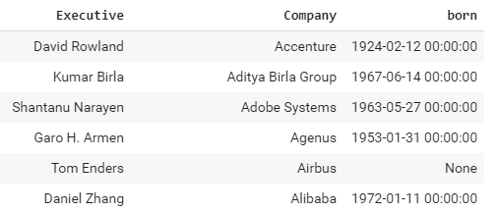
In SQL
company_ceos_df.to_sql('company_ceos', conn, if_exists="replace")
exec_df.to_sql('executives', conn, if_exists="replace")
pd.read_sql_query('select Executive, Company, born from company_ceos ' +\
'join executives on Executive=clean_name', conn)
Notes:
We can also do this in SQL by selecting the result columns we want in the result (SELECT clause), the relations to be joined in the FROM clause, and using “JOIN … ON” to specify that this is a join.
Note that in the Dataframe example, the result had 4 columns but here we have 3. This is because two of the columns in the Dataframe result HAVE to be the same so are redundant; we just got rid of them in the SQL.
We get better performance in general, when there are a large number (millions) of rows, if we use SQL due to the ability to specify indices and other optimizations.

Slide 41
What Did We Miss?
Looking at the results, there are more rows in the original companies table than there are in the final merge result.
The exact numbers will vary depending on when you run the notebook, but in our case it was 185 company rows but only 181 rows in the merge.
So it seems we have some missing companies (or CEOs)!
Maybe we don’t care
Or maybe we need to do more cleaning!
Notes:
If there are millions of rows and we only lose 4, maybe we don’t care. But perhaps the 4 missing ones are outliers in an important way, e.g. the wealthiest or the youngest, and might skew our results if they are dropped. So maybe we would want to clean more.

Slide 42
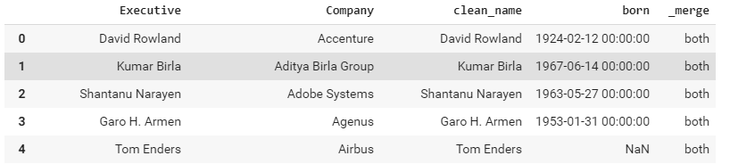
Let’s Try the Join Again As a Left Outerjoin
company_ceos_df[['Executive', 'Company']].merge(exec_df[['clean_name', 'born']],
left_on=['Executive'],
right_on=['clean_name’],
how="left", indicator=True)
Notes:
Let’s do a version of the merge which gives us more information about what is missing: outerjoin (left, right or full).
Outerjoin will include “partial” rows when one side doesn’t have a match on the other side.
Here, we are using the left outerjoin (called merge- how=“left” in Pandas) which includes all the tuples in the left dataframe (here, company_ceos_df) even those who don’t have a match in exec_df. Those who don’t have a match are padded with NaN (a null value, “Not a Number”) for clean_name and born.
The indicator=True adds a column to the output DataFrame called “_merge” with information on the source of each row, i.e. how it was produced.
Now we can see which CEOs we missed, and notice that several of the executive names have special characters which get mangled in the text encoding (e.g. the umlaut).
So we did not clean our data well enough!

Slide 43
Cleaning Data at Scale
Difficulty level: basic

Slide 44
How Do We Know Data Is Clean?
For our purposes, we “eyeballed it” and saw that the names had underscores or umlauts (not clean).
Looking at data is always good!
But it is best to not count on humans to look at data at scale.
Notes:
In general, when we get data from the web, how do we know that it is “good”? You need to know something about the data (the domain experts) to see where it fails.
One of the worst mistakes data scientists make is not looking at the data; just running a machine learning algorithm over the data without doing an initial sanity check may lead to very bad results.
In addition to looking at the data, we might need automated techniques.

Slide 45
Cleaning Data: Master Data + Validation Rules
“Master” data management:
Gather a complete, correct list of CEOs –store it in a master data model and compare against it
Many organizations manage this – “data governance” policies about who can update, how things are added, what is compared against it
Provide validation rules:
“Names should not have non-alpha characters”
“Birthdays should be non-null”
Must beware: may have false positives and false negatives
Notes:
The other thing we can do is to come up with automated checks for the data, most of which are somewhat incomplete – it is hard to capture all exceptions.
What some organizations do is to come up with a master list, with rules about how it can be updated. We can’t really do this for web data.

Slide 46
Simple Example
We think names should have alphabetic characters, except possibly:
Spaces
Hyphenation (e.g., “Jean-Luc”)
Apostrophes (e.g., “O’Malley”)
Periods (for initials)
So we can create a validation rule for this…
Notes:
To merge our data, here are some simple rules.

Slide 47
Validation Rule: Show All Bad Names & Raise Error…
replace_char = 'Q'
failed = False
for name in exec_df['clean_name']:
if not name.replace(' ', replace_char).\
replace('.', replace_char).\
replace('\'',replace_char).\
replace('-',replace_char).isalpha():
print ("Illegal name %s"%name)
failed = True
if failed:
raise AssertionError('Found illegal names!')

Slide 48
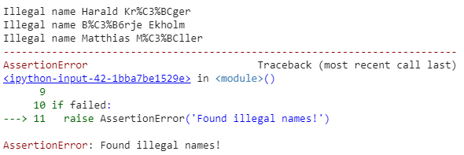
Validation Rule: Show All Bad Names & Raise Error…
replace_char = 'Q'
failed = False
for name in exec_df['clean_name']:
if not name.replace(' ', replace_char).\
replace('.', replace_char).\
replace('\'',replace_char).\
replace('-',replace_char).isalpha():
print ("Illegal name %s"%name)
failed = True
if failed:
raise AssertionError('Found illegal names!')
Notes:
This is what we get when we run it. We find names with special characters in them.
What do we do? We could convert them to a clean form through a conversion process. In our case, there are HTML character codes so we can write a function to turn them back into characters. But this might be a lot of work just to get the join to work. So we will focus on a more tolerant version of the join.

Slide 49
Record Linking
Difficulty level: intermediate

Slide 50
Record Linking
We have two approaches to handling bad names: (1) figure out how to recover the original names, or (2) make a more tolerant version of the join.
A general problem called “record linking”: looking at rows in different tables and figuring out if they should join
Is “SMITH, J” the same as “JON SMITH”?
Many tools: Tamr, Data Ladder, QualityStage, Magellan, etc.
Here, we can apply the same idea with Executive vs clean_name!
How does it work? We join the items as if they are the same if they are “similar” enough.
Notes:
There are many tools that can be used to do a more tolerant version of the join.

Slide 51
A Deep Dive: String Similarity
String equality is really easy to test:
def str_equal(x,y):
if len(x) != len(y):
return False
for i in range(0, len(x)):
if x[i] != y[i]:
return False
return True
How might we generalize?
Notes:
Simplest possible version of string equality … we want to relax the != to find “similarity” between strings.

Slide 52
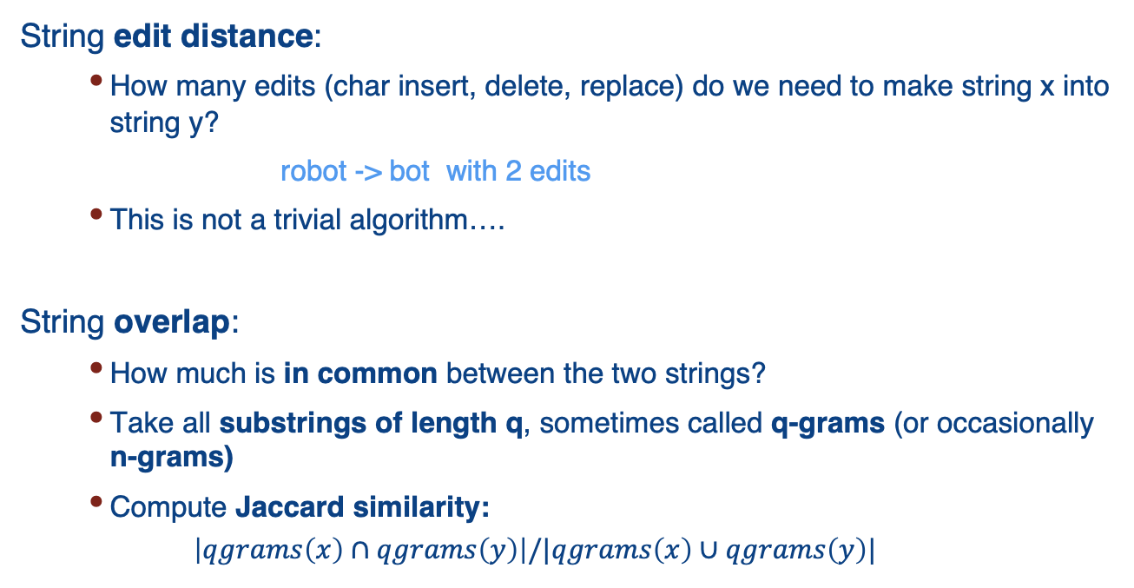
Two Main Approaches to String Similarity
String edit distance:
How many edits (char insert, delete, replace) do we need to make string x into string y?
robot -> bot with 2 edits
This is not a trivial algorithm….
String overlap:
How much is in common between the two strings?
Take all substrings of length q, sometimes called q-grams (or occasionally n-grams)
Compute Jaccard similarity:
$$\left|qgrams\left(x\right)∩qgrams\left(y\right)\right|/|qgrams\left(x\right)∪qgrams\left(y\right)|$$
Notes:
We will focus on string overlap because it is conceptually simpler and widely used. Here, we take fragments (substrings) of the strings and measure the percentage of fragments that are the same between the two strings. This is done using Jaccard similarity.

Slide 53
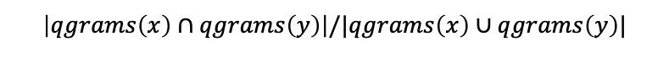
Q-Gram Example: 3-Grams on “robot” and “bot”
“Pad” the ends of the string by (q-1) characters:
robot → $$robot$$ bot → $$bot$$
Next, take all substrings of length q:
$$r
$ro
rob
obo
bot
ot$
t$$
$$b
$bo
bot
ot$
t$$
$$\left|qgrams\left(x\right)∩qgrams\left(y\right)\right|/|qgrams\left(x\right)∪qgrams\left(y\right)|$$
Finally, compute Jaccard similarity:
3 q-grams in common
9 total q-grams
Jaccard score = 3/9 = 0.333
Notes:
We use $ as padding; we are considering 3-grams, so we pad with 2 $ characters at each end.
1. Take a string, turn into a set of substrings of length q
2. Compare the sets for similarity, using the distance measure called Jaccard (size of intersection/ cardinality of the union)
Jaccard is a measure of the distance between sets

Slide 54
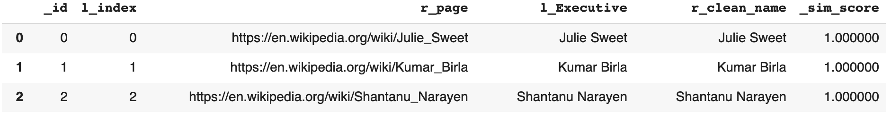
String Similarity in Record Linking
From the Magellan record linking tool set (https://sites.google.com/site/anhaidgroup/projects/magellan):
tok = sm.QgramTokenizer(qval=5,return_set=True)
output_pairs = ssj.jaccard_join(company_ceos_df, exec_df, 'index', 'page’,
'Executive', 'clean_name', tok, 0.35,
l_out_attrs=['Executive’], r_out_attrs=['clean_name'])
…
Notes:
Let’s see this in action using one of the record linking toolkits called Magellan. Magellan is a set of libraries for recording linking at scale (widely used, e.g. by Walmart)
Two components: Tokenizer pulls out the q-grams; the join looks at the similarity between the q-grams. Here q=5 (qval=5, ignore the return_set); we do a Jaccard join between the two tables using the q-gram tokenizer, with a threshold of 0.35.
This is the result: Some match perfectly, others match less well (e.g. Harald Kruger) – but the overlap is enough 0.444 so we will still use the match. So we have more rows in our linked result.

Slide 55
Presenting Wrangled Data: Plotting and Grouping Data
Difficulty level: basic

Slide 56
Is It All Good? What about Missing Data, Null Values?
183 matches out of 184 – probably OK?
In more detail: there are 0 false positives and 1 false negative
Now suppose we want to plot the CEO birthdays…
But not every Wikipedia page had a birthday: what do we do about unknown birthdays?
In Pandas, these show up as NaN (or NaT for datetime)
In SQL they are represented as NULL
One option: dropna(subset=[‘born’]) (or SQL “WHERE born IS NOT NULL) to remove all non-matches…
Notes:
What do we do about null values?
One option is to just drop rows with nulls in certain columns using dropna. This will drop rows if they have NULL values in any column – here we restrict where the nulls are looked for (i.e. the born column) using subset=[‘born’]
Another option is to fill in some sort of default value, e.g. the mean or mode – but this skews the data.
For plotting it is fine to leave nulls in as they will be ignored.

Slide 57
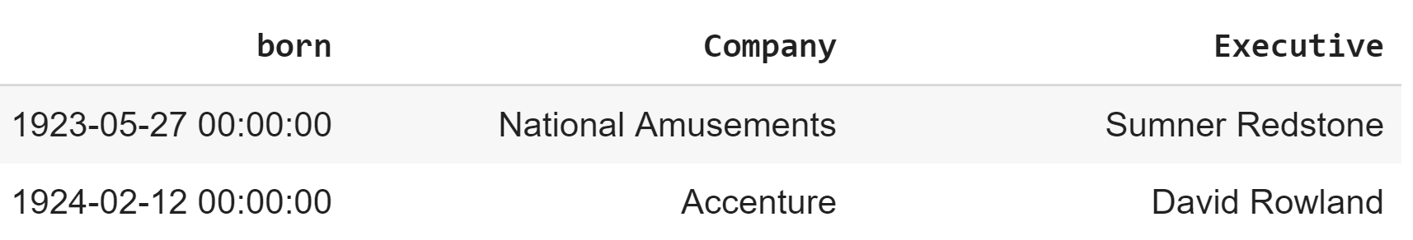
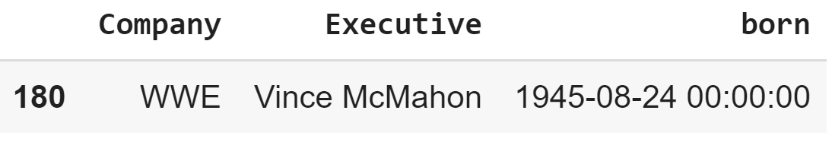
Grouping
Grouping is a simple idea: “bin” subsets of rows based on a common set of values
total.groupby(by='born').get_group\
(datetime.datetime.strptime('1945-08-24', '%Y-%m-%d'))
(for many datasets there would be more rows here)
Notes:
Recall that our goal is to understand whether or not most CEOs are older than 40, i.e. to get an idea of the distribution of birthdates.
Here we group CEOs using “groupby” and then show the group that was born on ‘1945-08-24’ using “get_group”. Note that it is just one person!

Slide 58
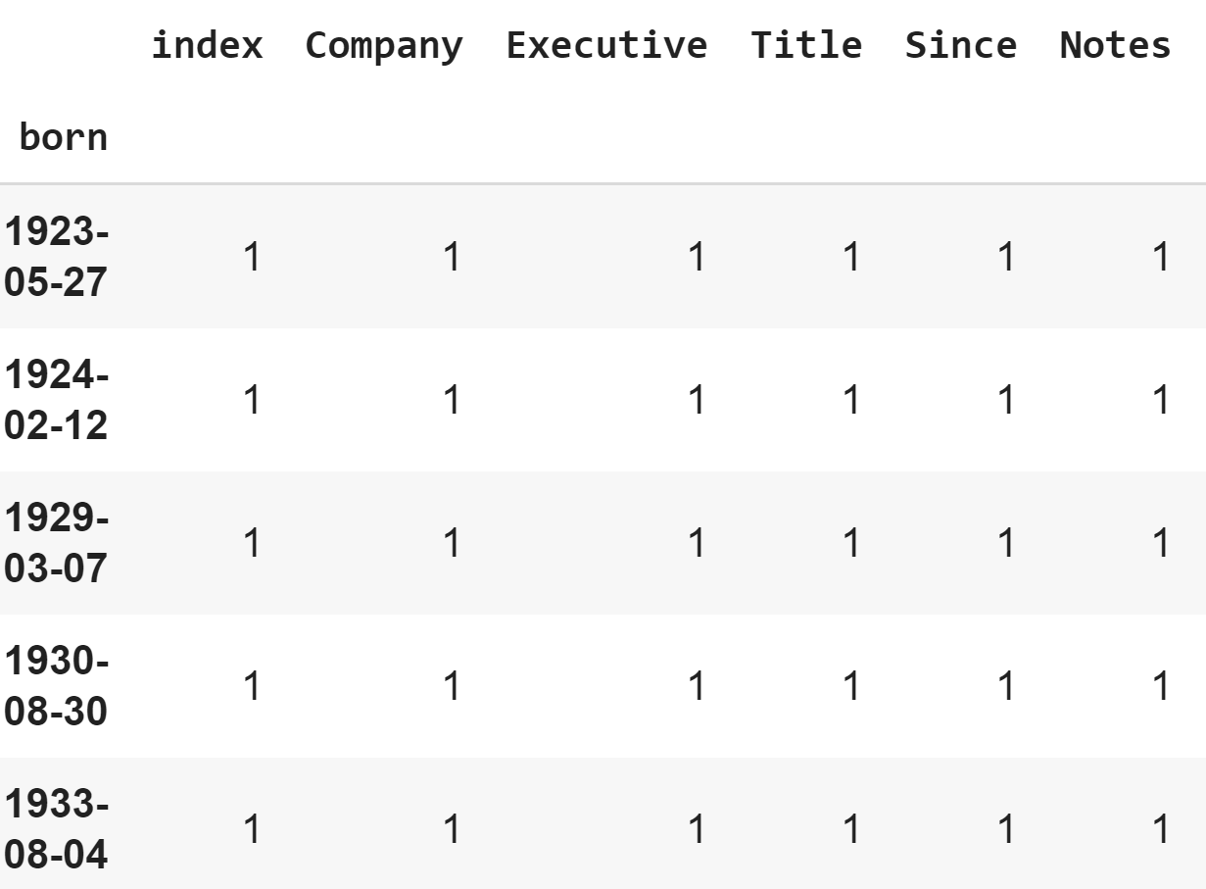
Grouping and Aggregation
Most commonly, we want to apply a function to (some of) the columns in a group, e.g., a count:
Groups by ‘born,’
excluding the NaNs
total.groupby(by='born').count()
pd.read_sql('select born, count(Company) from total_info ' +\
'where born is not null group by born', conn)
Notes:
Now we want to count how many CEOs are born on each day, and for this we use the function “count” over each group. So not many CEOs share a birthday!
We can do the same in SQL using “group by born” to create the groups, and then putting count(Company) in the select clause to do the counting.

Slide 59
Aggregating and Counting by Decade
bdays = total[['born']].dropna()​
bdays = bdays.applymap(lambda bday: str(int(bday.year / 10) * 10) + ‘s’)
exec_df[['born_decade']] = bdays
Now let’s get a sense of the age of CEOs by calculating the decade in which they were born.
Then we will plot a histogram, showing how many were born in each decade.
Notes:
To get a better sense of how birthdates cluster, we will group them into decades and plot by decade using a bar chart. So first, for every nonull born date we will calculate the decade (e.g. if they were born in 1945 it would be the 1940’s) using “applymap”, and then add as an extra column called “born_decade” in exec_df.

Slide 60
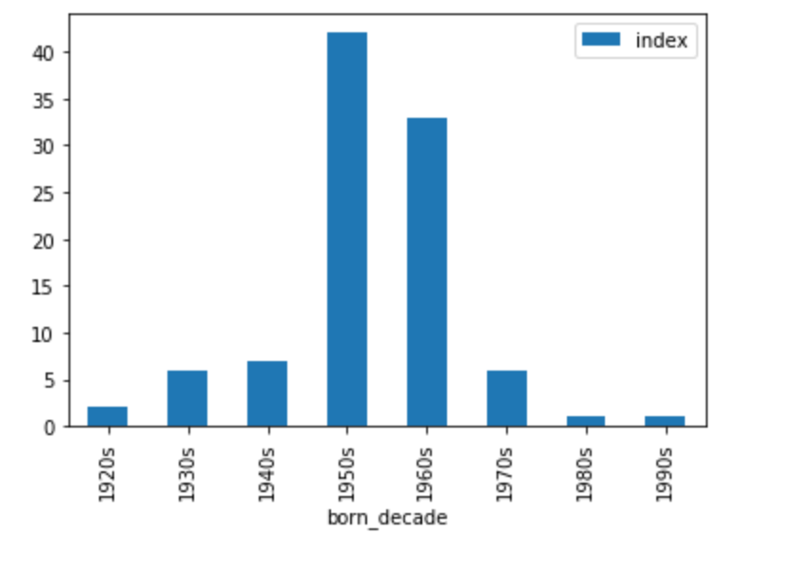
Plotting by Decade
exec_df[['born_decade']].reset_index().
groupby('born_decade').count().plot(kind='bar')
Notes:
This bar chart shows the number of CEOs born in each decade. It shows that most CEOs are born before the 1980s; the biggest decades are the 1950s and 1960s, meaning that the age of most CEOs is about 50 or 60.

Slide 61
Summary of Grouping
Grouping “bins” sets of tuples
You can apply aggregate functions such as count or sum to the columns
Beware of how null values are treated!
Notes:
No tuple can be in more than one bin. Need to make sure that the “bins” are the right structures, i.e. decades instead of individual days.
Grouping and aggregating is sometimes also called reducing.

Slide 62
Recap: Acquiring & Integrating Data
We looked at:
Basic mechanisms for getting tabular data from CSV, HTML tables, and relational databases (urlib, …..)
Extraction from HTML documents, based on patterns via XPath
Basic table manipulation, including modifying schema and data (projection, selection, merge…)
Linking data, by value and by similarity
Basics of data cleaning
Simple grouping and visualization
Examples in DATA-WRANGLING-import-link-mixed.ipynb

